Slide 1

Sagittarius
Astronomy
Club
Academic department

Slide 2
Why are we here?
Academic department

Slide 3
The relationship between
creativity and age
Academic department

Slide 4
Gaining Creativity
Academic department

Slide 5

For example
Kerbal Space Program
Academic department

Slide 6
Our advantage
Academic department

Slide 7
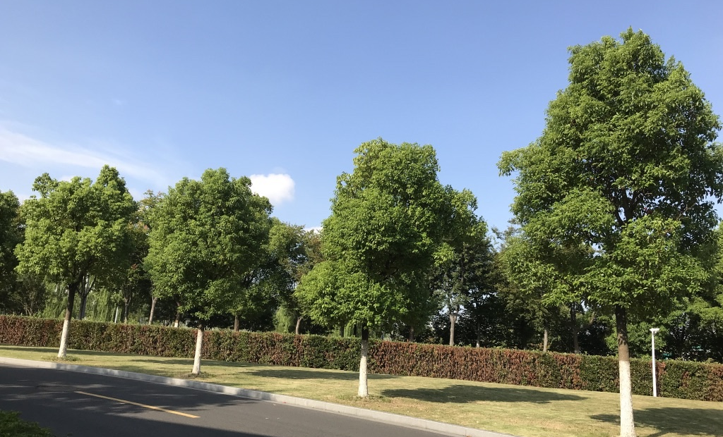
Knowledge and vision
Shot in the Duke Kunshan University
Academic department

Slide 8
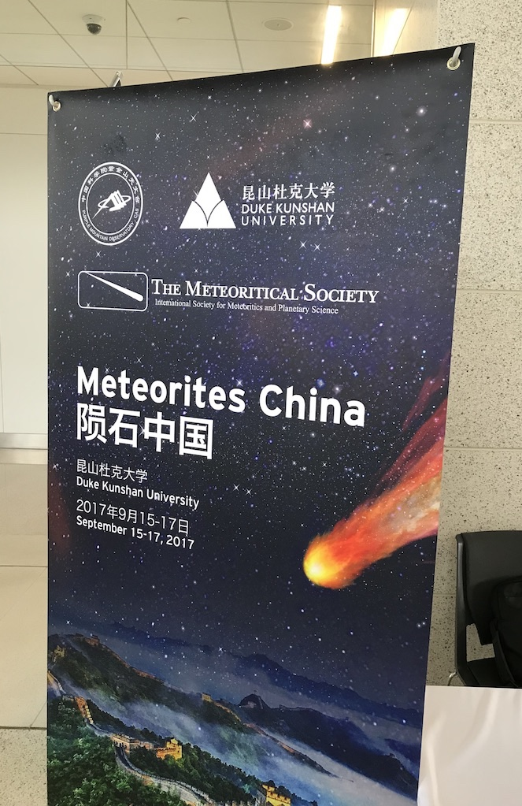
Knowledge and vision
Academic department

Slide 9
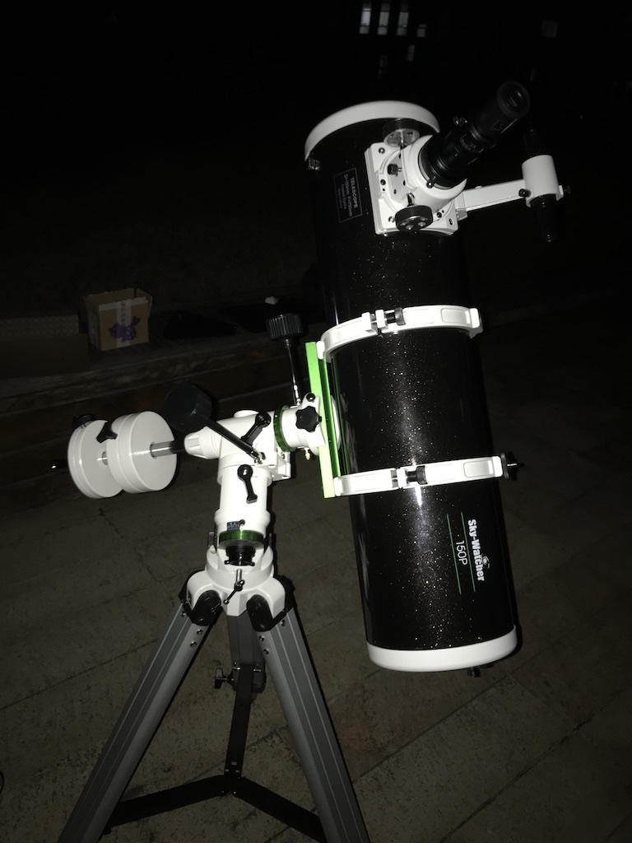
Knowledge and vision
Academic department

Slide 10
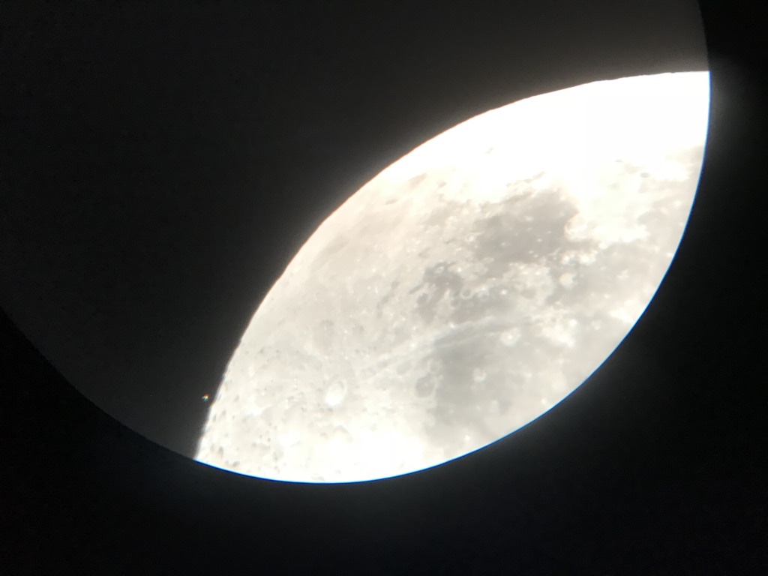
Academic department

Slide 11
Friendship

Slide 12
Call for papers
Academic department

Slide 13
Welcome
Academic department

